Slide 1
Increase by a percentage
Understanding multiplicative relationships: percentages and proportionality

Slide 2
how to use Oak lessons

Slide 3
I can calculate percentage changes (increase).

Slide 4
Proportion is a part to whole (sometimes part to part) comparison. If two things are proportional then the ratio of part to whole is maintained and the multiplicative relationship between parts is also maintained.

Slide 5

Increase by a percentage
Increasing an amount by a percentage
Using a multiplier

Slide 6
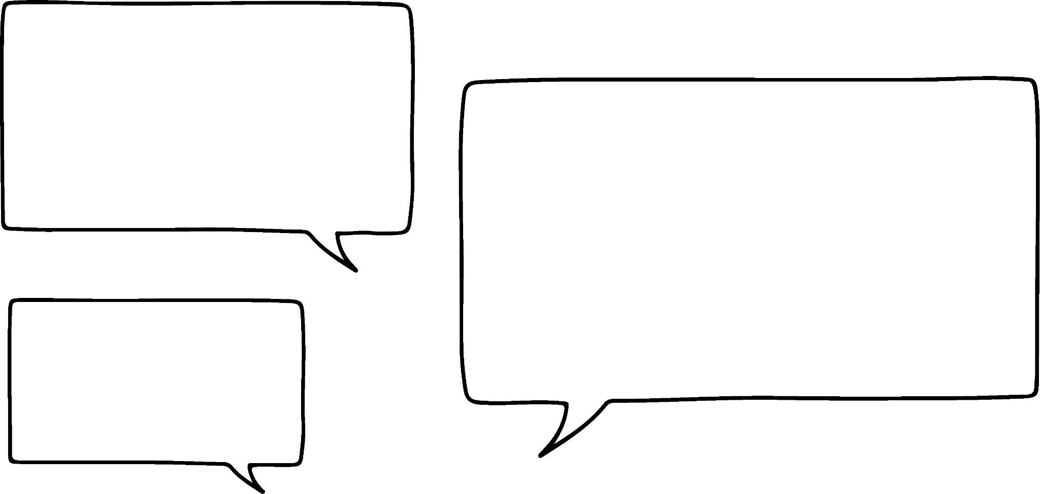

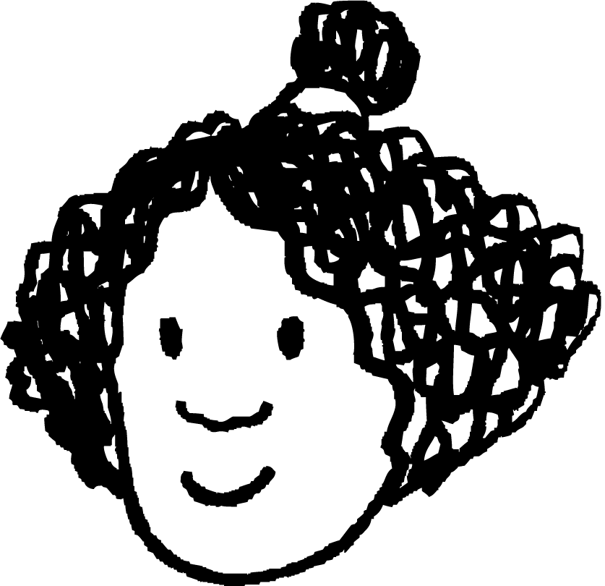
Increasing an amount by a percentage
In this lesson, we will be looking at increasing an amount by a percentage. However, before starting it is important to know if it is possible to increase something beyond 100%.
You need to try harder Laura! Give it 110%!
That doesn’t make sense Izzy!
Why is Izzy’s comment incorrect?
Laura
Izzy

Slide 7
Increasing an amount by a percentage
It is incorrect because the most effort you can give is 100% (i.e. all of your effort) although it’s a common phrase used in sports coaching. What 100% effort looks like can, of course, vary each day.
You need to try harder Laura! Give it 110%!
That doesn’t make sense Izzy!
What do you think?
Laura
Izzy

Slide 8
Increasing an amount by a percentage
Is 110% possible or not possible in each of these situations?
Scoring 110% on an exam.
Scoring 110% on an exam: not possible, as the maximum score is 100%.
‘A house costing 110% of its original cost’. Yes, this is possible.
The cost of a house increasing by 110%.

Slide 9
Increasing an amount by a percentage
Here is a bar model showing £600.
If someone said they would give you an extra 10%, how much money would you have in total?
Divide the 100% into 10 equal parts
10%
10%
10%
10%
10%
10%
10%
10%
10%
10%
60 | 60 | 60 | 60 | 60 | 60 | 60 | 60 | 60 | 60
£600
Each part is 10%
100%
Each part is £60

Slide 10
Increasing an amount by a percentage
Here is a bar model showing £600.
If someone said they would give you an extra 10%, how much money would you have in total?
10%
60 | 60 | 60 | 60 | 60 | 60 | 60 | 60 | 60 | 60
60
100%
Adding 10%

Slide 11
Increasing an amount by a percentage
Here is a bar model showing £600.
If someone said they would give you an extra 10%, how much money would you have in total?
10%
£600
60
100%
You would have £660

Slide 12
Increasing an amount by a percentage
Here is a bar model showing £600.
Given £600 was the original 100%, what percentage of £600 is now shown on the bar model?
100%
10%
£600
60
100%
£660 is 110% of £600

Slide 13
Increasing an amount by a percentage
Fill in the blanks using the bar models:
a)
b)
30%
80
8
8
8
104 is 130% of 80
100%
60%
70
7
7
7
7
7
7
8
8
8
112 is 160% of 70
100%

Slide 14

Increasing an amount by a percentage
In mathematics there are many different ways to write a question, but they all mean the same thing.
For example:
How many different ways can you write the question
“Work out 60% of 900”?
Decrease 900 by 40%
0.6 × 900
of 900
× 900

Slide 15


Increasing an amount by a percentage
How would I increase £240 by 35%? My bar model only shows 10% parts.
Easy! Just find 5% by halving 10%
Jacob
Sofia
10%
10%
10%
10%
10%
10%
10%
10%
10%
10%
£240
100%

Slide 16
Increasing an amount by a percentage
10% is 24, so 5% is 12
Now I can increase £240 by 35%
So what is 5% of £240?
Jacob
Sofia
5%
10%
12
24
= £240
100%

Slide 17
Increasing an amount by a percentage
So what is the answer when you increase £240 by 35%?
240 + 24 × 3 + 12 = £324
Sofia
We say that 135% of £240 is £324
30%
5%
24
24
24
12
= £240
135 % = £324
100%

Slide 18
Increasing an amount by a percentage
By drawing a bar model, work out 155% of 120
50%
5%
120
12
12
12
12
12
6
100%
Firstly, identify the 10%
Each 10% represents 12
50% represents 12 × 5 = 60
Finding 5% is 6
155% of 120 is 186

Slide 19
Increasing an amount by a percentage
1) Write questions and answers for the representation of these bar models:
a)
b)
c)
40
20
100%
50%
200
114
100%
57%
80
20
100%
25%

Slide 20
Increasing an amount by a percentage
2) Drawing bar models, show how you work out:
a) An increase of 30% to 640
b) 125% of 900
c) Increase 700 by 95%

Slide 21
Increasing an amount by a percentage
1) Write questions and answers for the representation of these bar models:
a)
40
20
100%
50%
Possible questions:
Increase 40 by 50%
Work out 150% of 40
What percentage of 40 is 60?
Answers:
60
60
150%

Slide 22
Increasing an amount by a percentage
1) Write questions and answers for the representation of these bar models:
b)
200
114
100%
57%
Possible questions:
Increase 200 by 57%
Work out 157% of 200
What percentage of 200 is 314?
Answers:
314
314
157%

Slide 23
Increasing an amount by a percentage
1) Write questions and answers for the representation of these bar models:
c)
80
20
100%
25%
Possible questions:
Increase 80 by 25%
Work out 125% of 80
What percentage of 80 is 100?
Answers:
100
100
125%

Slide 24
Increasing an amount by a percentage
2) Drawing bar models, show how you work out:
An increase of 30% to 640
30%
640
64
64
64
100%
Increasing 640 by 30% is 640 + 64 × 3 = 832

Slide 25
Increasing an amount by a percentage
2) Drawing bar models, show how you work out:
b) 125% of 900
20%
5%
900
90
90
45
100%
125% of 900 is 900 + 90 × 2 + 45 = 1125

Slide 26
Increasing an amount by a percentage
2) Drawing bar models, show how you work out:
c) Increase 700 by 95%
90%
5%
700
70 | 70 | 70 | 70 | 70 | 70 | 70 | 70 | 70
35
100%
Increase 700 by 95% is 700 + 70 × 9 + 35 = 1365

Slide 27
Increasing an amount by a percentage
2) Drawing bar models, show how you work out:
c) Increase 700 by 95%
35
5%
700
700
100%
100%
A more efficient way to increase 700 by 95% is to add 100% and subtract 5%
700 + 700 - 35 = 1365

Slide 28
Increase by a percentage
Increasing an amount by a percentage
Using a multiplier

Slide 29
Using a multiplier
Here we have a double number line showing 100% is 80
We can extend the double number line to find percentages beyond 100%
100%
0%
Percentage
Amount
0
80
Let’s look at working out 120% of 80

Slide 30
Using a multiplier
How do you think we can find the value of 120% of 80?
10% is 8
So 20% is 16
+20%
10%
20%
100%
120%
0%
Percentage
Amount
0
8
96
16
80
16

Slide 31
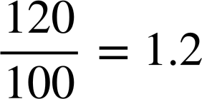
Using a multiplier
How do you think we can find the value of 120% of 80?
Another approach is using the multiplicative relationship.
The multiplier is
× 1.2
100%
120%
0%
Percentage
Amount
0
80
96
× 1.2

Slide 32
Using a multiplier
Label the correct multiplier on these double number lines:
× ……..
100%
130%
0%
Percentage
Amount
0
120
156
× ……..
× ……..
100%
115%
0%
Percentage
Amount
0
340
391
× ……..

Slide 33
Using a multiplier
Label the correct multiplier on these double number lines:
× 1.3
100%
130%
0%
Percentage
Amount
0
120
× 1.3
156
× 1.15
100%
115%
0%
Percentage
Amount
0
340
391
× 1.15

Slide 34
Using a multiplier
Removing the double number lines, can you work out the multiplier to increase any amount by 35%?
× ……..
100%
135%
0%
Percentage
Amount
0

Slide 35
Using a multiplier
Removing the double number lines, can you work out the multiplier to increase any amount by 35%?
× 1.35
100%
135%
Can you explain how to quickly find this multiplier?
Given 35% as a decimal is 0.35 and 100% as a decimal is 1, summing them gives 1.35

Slide 36
Using a multiplier
Identify the multiplier when any number is:
Increased by 40%
Increased by 34%
Increased by 78%
Increased by 16%
Increased by 4%
Increased by 200%
Increased by 2.3%
× 1.4
× 1.34
× 1.78
× 1.16
× 1.04
× 3
× 1.023

Slide 37
Using a multiplier
Using a multiplier and the associative law makes finding the percentage of an amount easier without a calculator.
For example, increase 48 by 32%
We need to work out
48 × 1.32 = 48 × 132 × 0.01
4000
✕ | 20 | 4
100
80
2
800
✕ | 40 | 8
100 | 4000 | 800
30 | 1200 | 240
2 | 80 | 16
1200
240
80
+ 16
= 6336 × 0.01
= 63.36
6336
Increasing 48 by 32% is 63.36

Slide 38
Using a multiplier
Match the calculation with the question:
Increase 40 by 65%
65 × 1.65
Work out 125% of 40
40 × 1.65
Increase 65 by 56%
40 × 1.25
Work out 156% of 56
65 × 1.56
Increase 65 by 65%
56 × 1.56

Slide 39
Using a multiplier
2) Work out the amount of money when £640 has been increased by 41%
3) Work out 138% of 700
4) Aisha tries to increase £40 by 5% by working out 40 × 1.5
Explain why she is incorrect and correctly work out the answer.

Slide 40
Using a multiplier
Match the calculation with the question:
Increase 40 by 65%
65 × 1.65
Work out 125% of 40
40 × 1.65
Increase 65 by 56%
40 × 1.25
Work out 156% of 56
65 × 1.56
Increase 65 by 65%
56 × 1.56

Slide 41
Using a multiplier
2) Work out the amount of money when £640 has been increased by 41%
3) Work out 138% of 700
4) Aisha tries to increase £40 by 5% by working out 40 × 1.5
Explain why she is incorrect and correctly work out the answer.
640 × 1.41 = 902.4
£640 increased by 41% is £902.40
700 × 1.38 = 966
Aisha worked out an increase of 50% not 5% of 40
Increasing 40 by 5% is 40 × 1.05 = 42 so her answer should be £42

Slide 42
Increase by a percentage
Understanding the context of the question tells us if we can increase anything beyond 100%.
If an increase is possible, double number lines and bar models are helpful visual approaches to work out the increase.
It is important to remember the same question can be asked but in different ways, e.g. Increase 70 by 12% is the same as 112% of 70
Using a decimal multiplier can be a good approach to work out a percentage increase.

Slide 43

© Oak National Academy 2024.
Produced in partnership with Mathematics in Education and Industry.
Licensed on the Open Government Licence v3.0, except where otherwise stated. See Oak terms and conditions.

